Slide 1
Building a Simple Crawler on a Toy Internet
JR Oakes

Slide 2
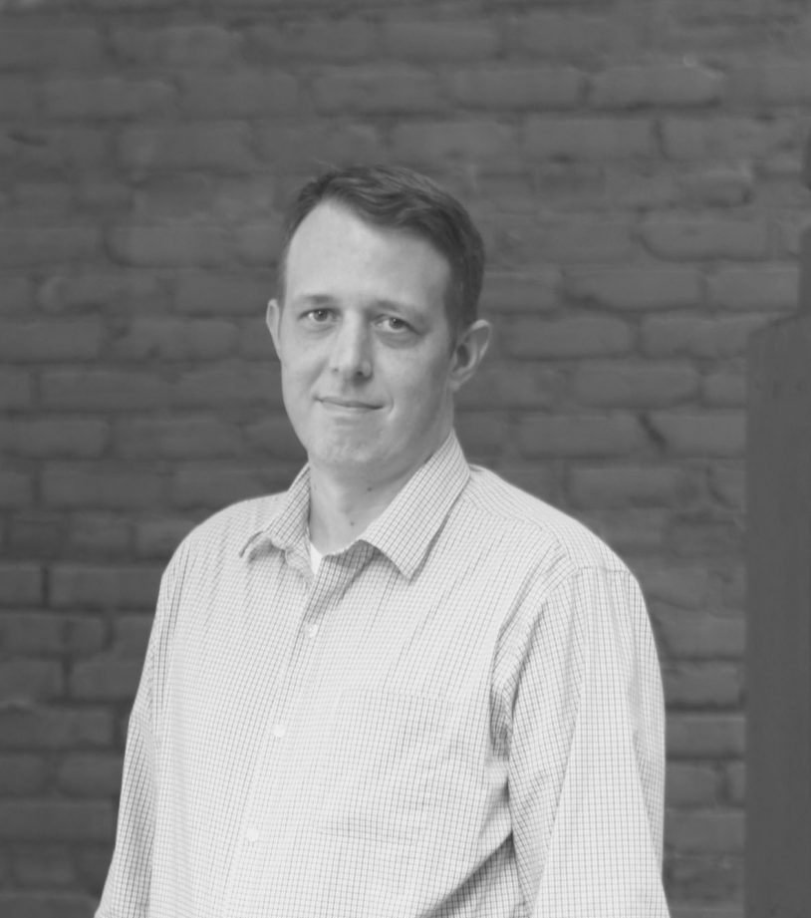
About Me
Senior Director, Technical SEO Research, at @LocomotiveSEO
Passionate about:
Development
Learning
Community
Technology

Slide 3
About Me
Write some and do the Twitter thing.
Share as much as I can on Github.
Love to organize meetups
Always testing something
Love the brilliant team at Locomotive

Slide 4
What we will learn

Slide 5
What we will learn
Overview of Crawling Landscape
Key Components of Crawler
Building a Toy Internet
Building a Crawler and Renderer

Slide 6
Overview of Crawling Landscape

Slide 7
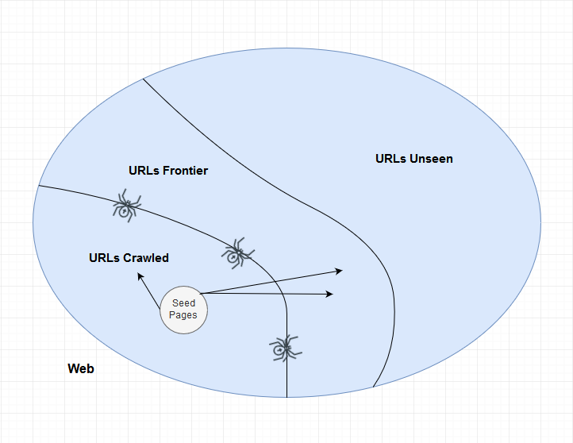
The Web is Big
We have worked on sites with as many as a billion potential pages. Google only crawls (or knows about) a fraction of those.
Crawled
Want to Crawl (frontier)
Unseen (or not wanted to be seen)

Slide 8
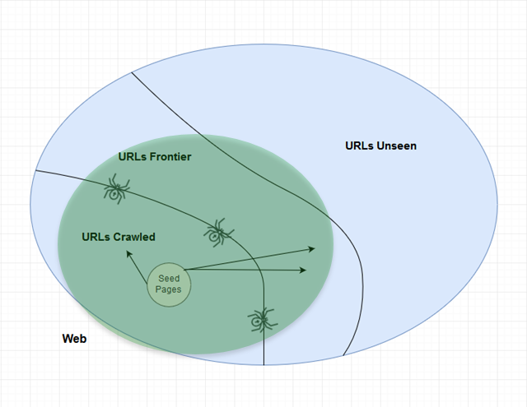
The Web is Big
PageRank, or node popularity metrics, is a good way to measure how deep to go.

Slide 9
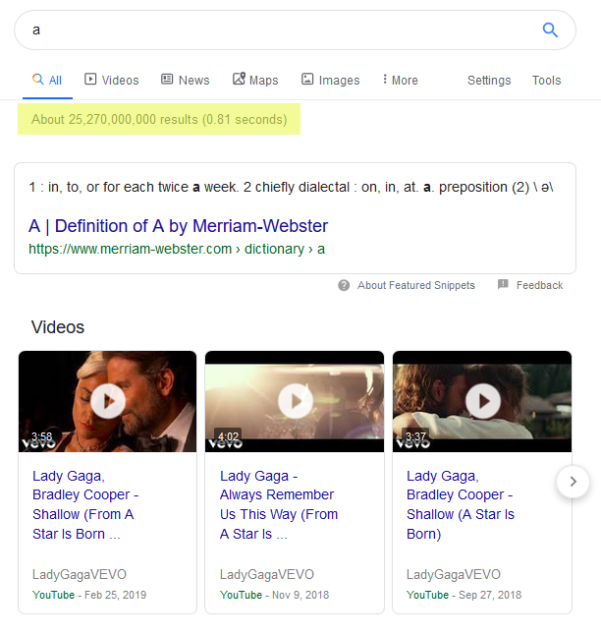
The Web is Big
Google knows about over 25 BILLION results.

Slide 10
What a crawler must do
Be robust. Handle spider traps and malicious behavior.
Be distributed. Run across many machines.
Be scalable. Easy to add more machines.
Be efficient. Use network and processing resources wisely.
Prioritize. Know the quality and priority of pages.
Operate continuously.
Be adaptable. Easy to change with new data / web needs.
Be a good citizen. Respect robots.txt and server load.
Ref: [Crawling and Duplicates, Chris Manning and Pandu Nayak] (http://web.stanford.edu/class/cs276/19handouts/lecture18-crawling.ppt)

Slide 11
Key Components of Crawler

Slide 12
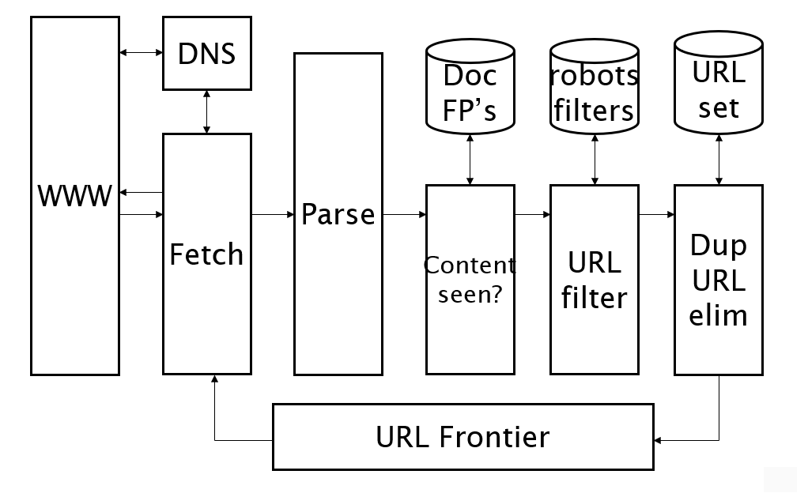
Basic Crawl Architecture
Ref: [Crawling and Duplicates, Chris Manning and Pandu Nayak] (http://web.stanford.edu/class/cs276/19handouts/lecture18-crawling.ppt)

Slide 13
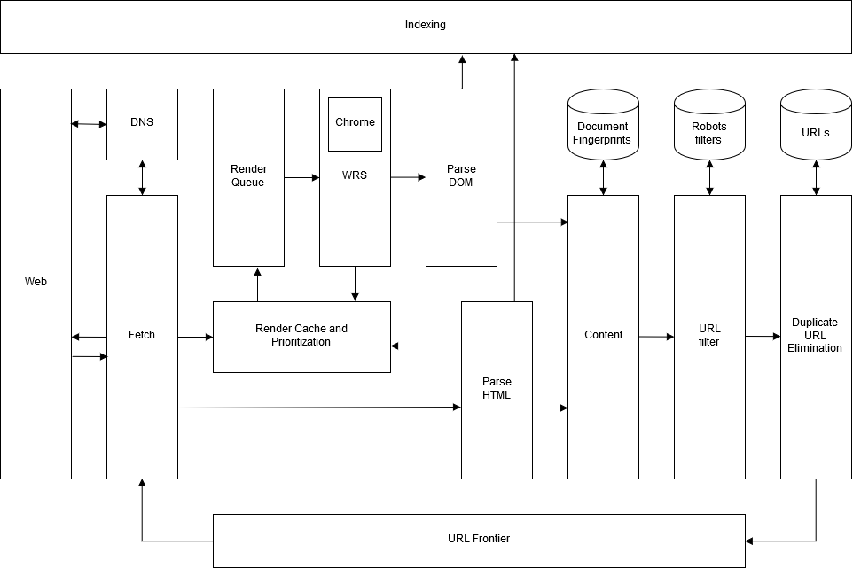
My Inferred Crawl Architecture

Slide 14
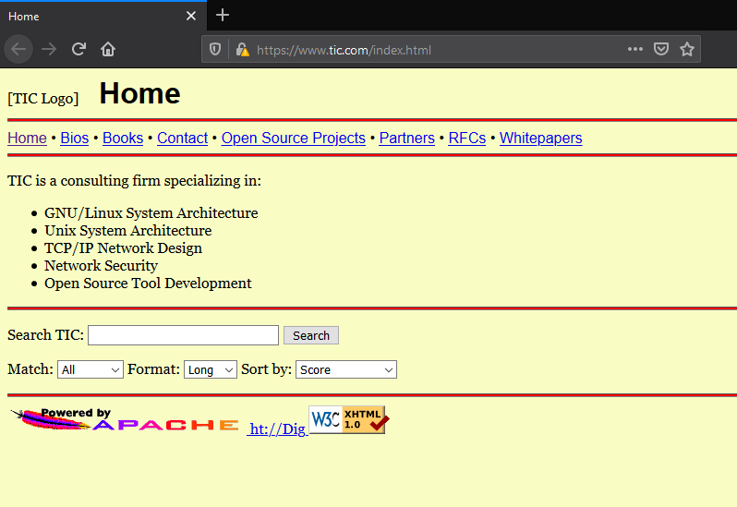
My Inferred Crawl Architecture
Hard to believe Google is wasting resources to render something that has not changed in 40 years.

Slide 15
Key Learnings
Frontier is broken into two sections, a Front Queue, that manages priority, and a Back Queue that manages politeness
All queues are FIFO
Each host has its own Back Queue
Min Hashes (Sketches) are an effective way of deduping content
Duplicates vs Near Duplicates measured by edit distance
Everything is cached to reduce latency
URL normalization is handled at the parser (eg /page-path/ to https://domain/page-path/)
There are interesting things that can happen in the DOM rather than just parsing retrieved URL

Slide 16
Building a Toy Internet

Slide 17
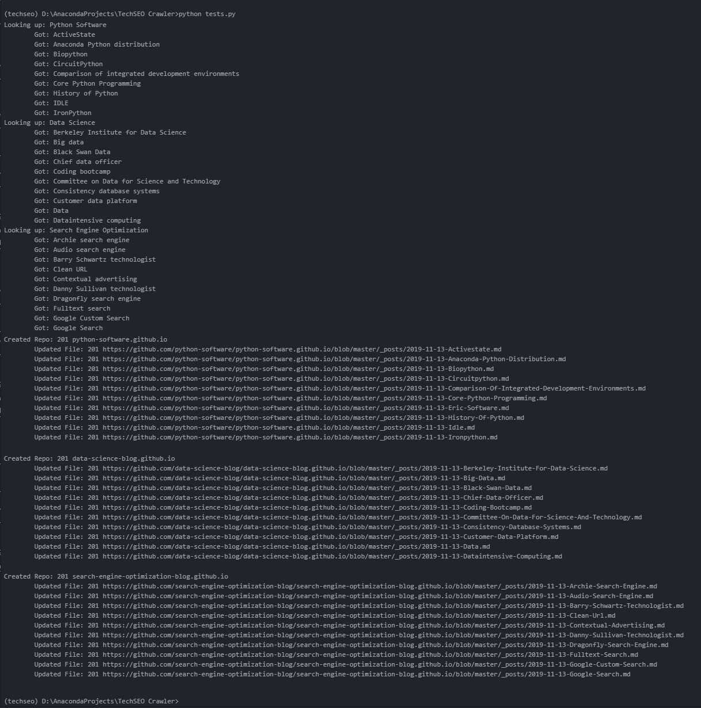
Criteria
Build quickly with topically similar pages for each site
Exist on separate domains
Linked to each other, but not to any other pages on the internet
Contain basic SEO elements like title, description, canonical, etc

Slide 18
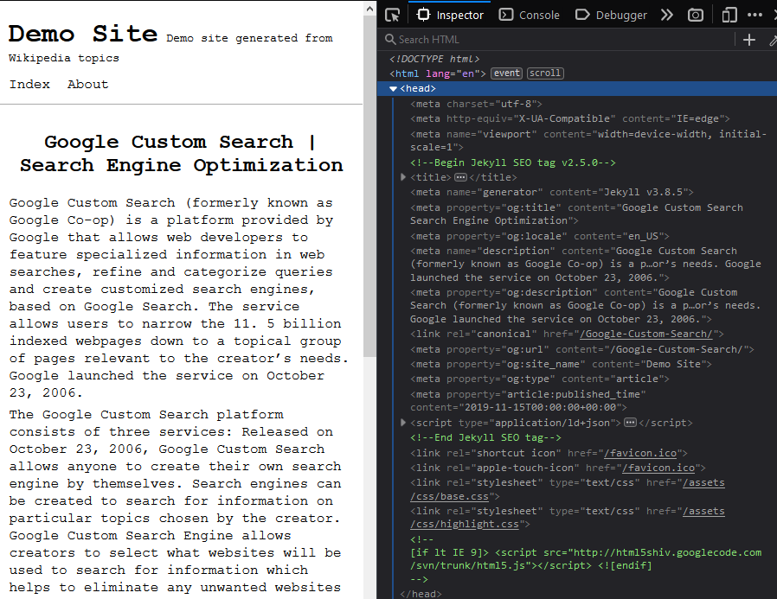
Solution
Github Pages
Jekyll
Wikipedia
Python
search-engine-optimization-blog.github.io
data-science-blog.github.io
python-software.github.io

Slide 19
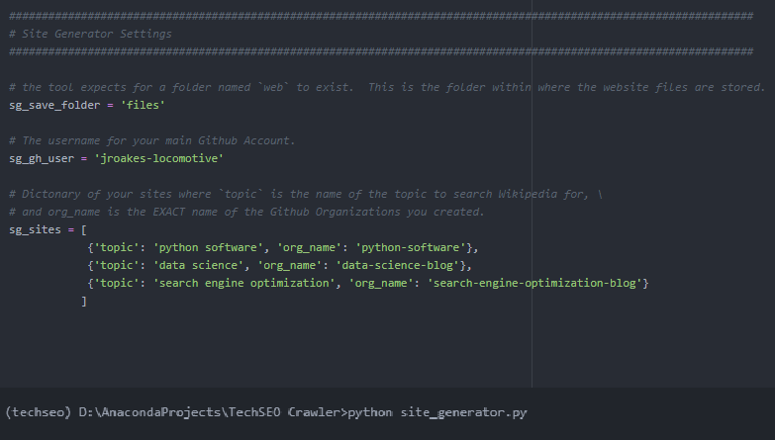
PBN Maker 3000

Slide 20
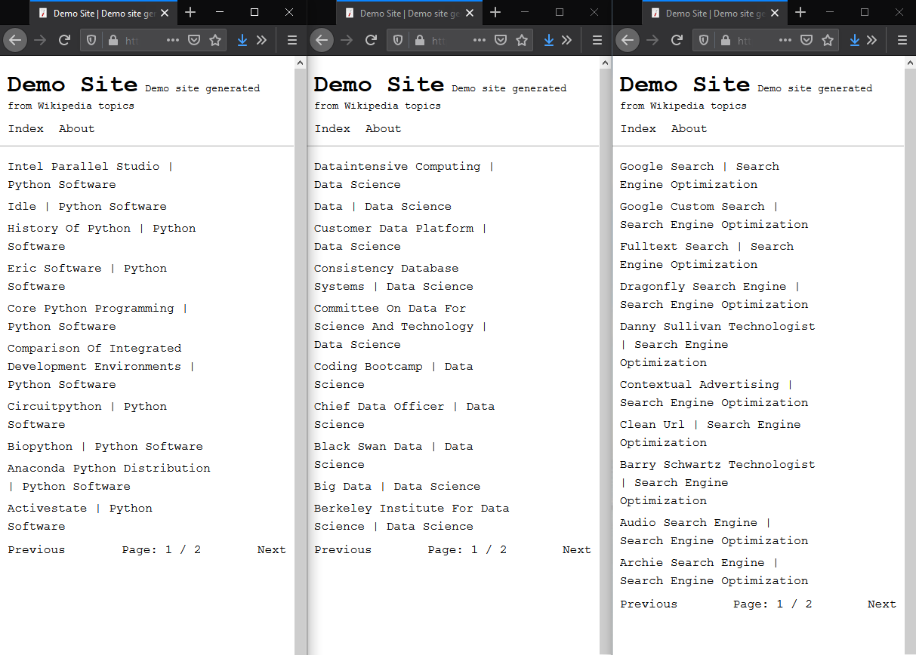
PBN Maker 3000

Slide 21
Building a Crawler and Renderer

Slide 22
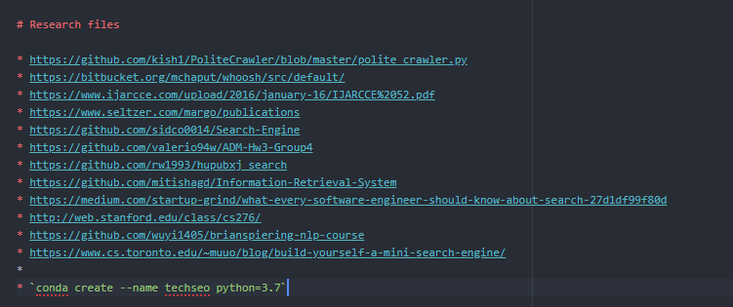
Step One
I have no idea how to start. So let’s do some research.
I <3 Github

Slide 23
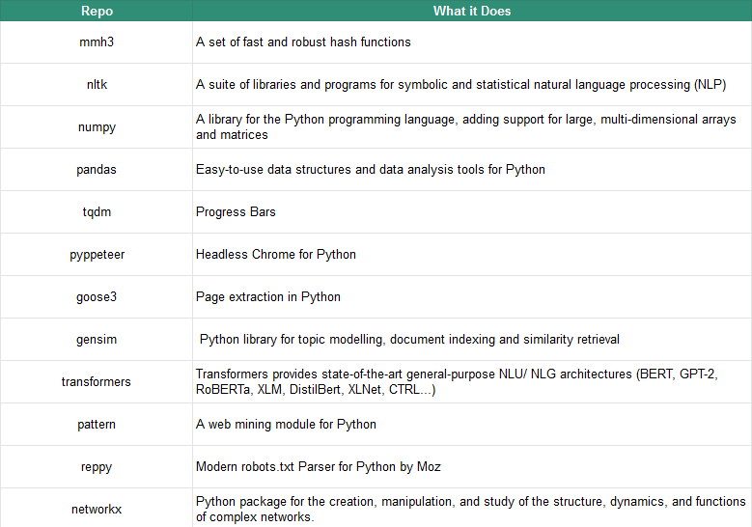
Step Two
I don’t want to reinvent the wheel, so let’s see what is already out there that I can use.

Slide 24

Step Three
A lot of coffee
… and some beer.

Slide 25
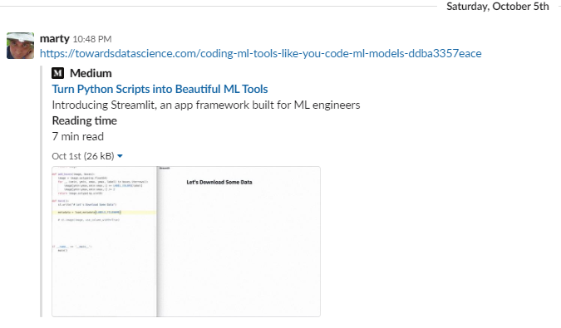
A little help along the way
Streamlit is the first app framework specifically for Machine Learning and Data Science teams. So you can stop spending time on frontend development and get back to what you do best.

Slide 26
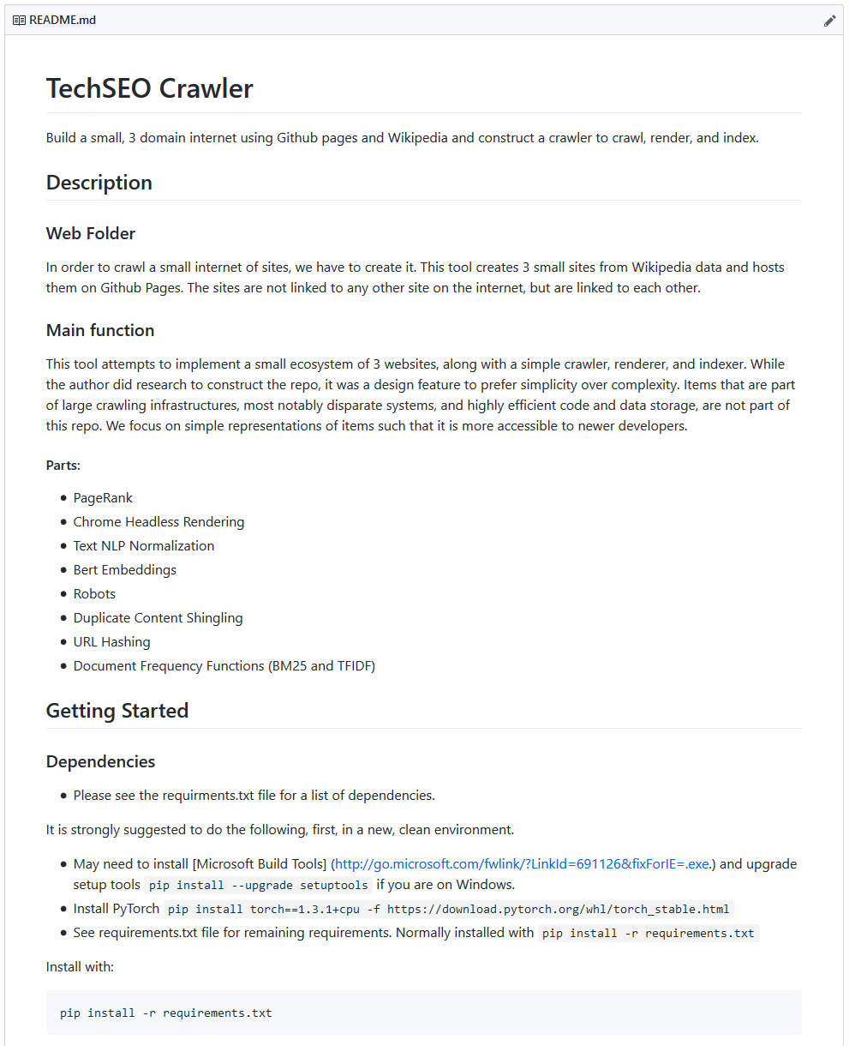
Criteria
Use existing libraries where possible
Be hardy enough to crawl my toy internet
Make it as simple and approachable as possible (e.g. I use Pandas a lot)
Try to be true (as possible) to what is known that Google does
Process linearly. No threading or extra services
Include unit testing
Include a Jupyter Notebook
Include READMEs
Include a simple indexer and search apparatus to play with results (Thanks John M.!)

Slide 27
Parts
PageRank
Chrome Headless Rendering
Text NLP Normalization
Bert Embeddings
Robots
Duplicate Content Shingling
URL Hashing
Document Frequency Functions (BM25 and TFIDF)

Slide 28
Learnings
Applying PageRank to similar document clusters is an effective way of picking the right one.
Deciding where to process and where (and when) to update values is hard. (e.g. canonical tags for crawling and consolidation in HTML vs Rendered).
Index compression techniques made my eyes glaze over.
BERT models need all the (or most of) content.

Slide 29
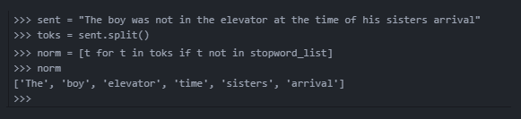
Learnings

Slide 30
Learnings
Applying PageRank to similar document clusters is an effective way of picking the right one.
Deciding where to process and where (and when) to update values is hard. (e.g. canonical tags for crawling and consolidation in HTML vs Rendered).
Index compression techniques made my eyes glaze over.
BERT models need all the (or most of) content.
BERT is easily accessible.

Slide 31
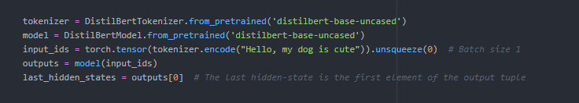
Learnings
https://github.com/huggingface/transformers
Embeddings

Slide 32
Learnings
Applying PageRank to similar document clusters is an effective way of picking the right one.
Deciding where to process and where (and when) to update values is hard. (e.g. canonical tags for crawling and consolidation in HTML vs Rendered).
Index compression techniques made my eyes glaze over.
BERT models need all the (or most of) content.
BERT is easily accessible.
I made some things waaaaayy simpler than they would be in real life.

Slide 33
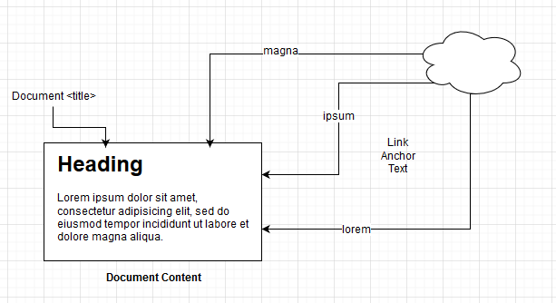
Learnings

Slide 34
Learnings
Applying PageRank to similar document clusters is an effective way of picking the right one.
Deciding where to process and where (and when) to update values is hard. (e.g. canonical tags for crawling and consolidation in HTML vs Rendered).
Index compression techniques made my eyes glaze over.
BERT models need all the (or most of) content.
BERT is easily accessible.
I made some things way simpler than they would be in real life.
Sentencepiece and BPE encoding is revolutionary for indexes and NLG
A minor code change can make the crawler go crazy. Hats off to Google and Screaming Frog.
Minhash comparison made checking rendering to crawled comparison, easy.

Slide 35
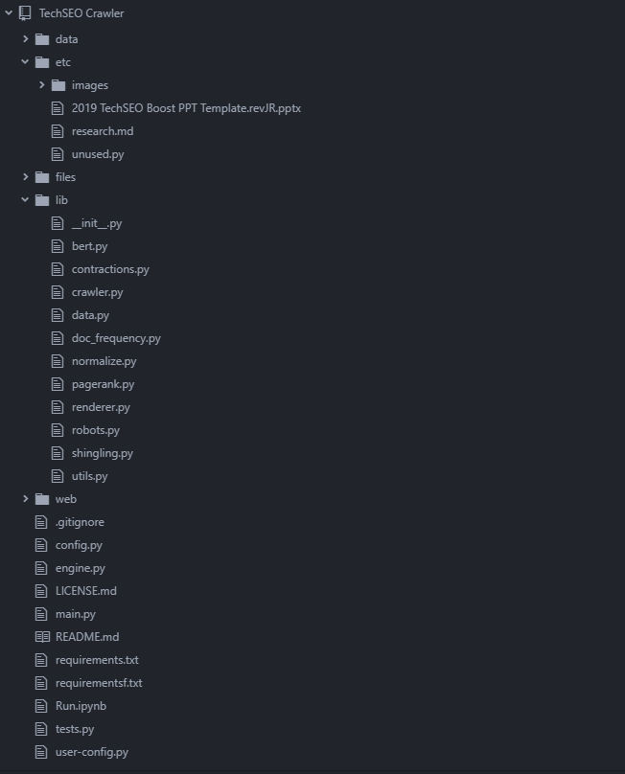
Result
A crawler written in Python that we are releasing as open source.
Keep in mind:
This was written in a month
Google engineers would laugh at it
It probably has bugs
It is really fun to play around with

Slide 36
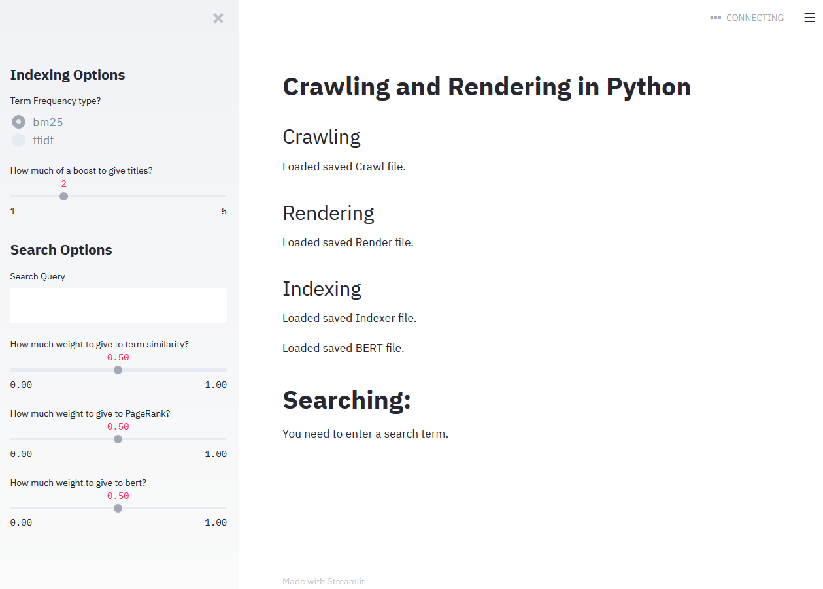
Result
We also built a simple UI in Streamlit so you can play around with the results and parameters.

Slide 37
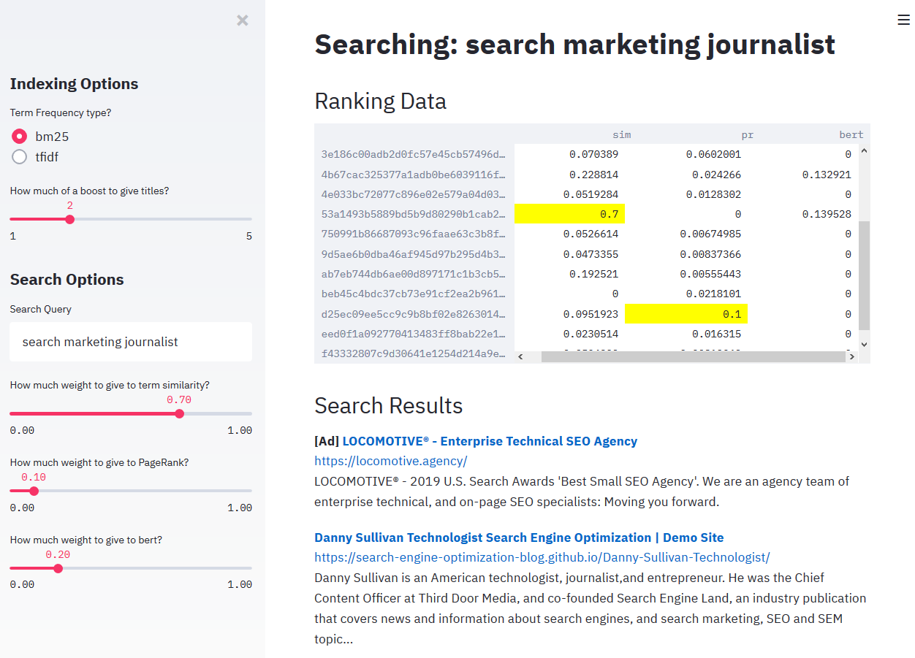
Result
Complete with Ads!

Slide 38
Thank You
Start playing at the link below
https://locomotive.agency/coal-crawler-renderer-indexer-caboose
–
Find me on Twitter at: @jroakes

